Slide 1
PyPy
The Art of Generating Virtual Machines
Samuele Pedroni Laura Creighton
Armin Rigo Jacob Hallén
http://www.codespeak.net/pypy

Slide 2
Prolog
Javascript
Squeak
RPy
RPy
Py
RPy
Translator
RPy
Javascript
PyPy
PyPy
Squeak
PyPy
with JIT
Py
POSIX
POSIX
POSIX
POSIX
POSIX
CLI/.NET
POSIX
POSIX
POSIX
PyPy
with
Stackless
PyPy
Py
Prolog
Py
PyPy
with
Taint
POSIX
POSIX
POSIX
POSIX
POSIX
JVM/Java
POSIX
POSIX
CLI/.NET

Slide 3
PyPy
Architecture

Slide 4
CPython
Py
Program
Py
C
POSIX

Slide 5
PyPy
Py
CPython
Py
Program
Py
Py
C
POSIX
POSIX
POSIX

Slide 6
PyPy
Py
RPy
Translation
PyPy
Py
C
POSIX
POSIX
POSIX

Slide 7
PyPy
Py
Program
Py
C
POSIX
POSIX
POSIX

Slide 8
PyPy
Py
RPy
RPy
Translator
Py
PyPy
Py
C
POSIX
POSIX
POSIX

Slide 9
PyPy
Py
RPy
Translator
PyPy
Py
PyPy
Py
PyPy
Py
POSIX
C
POSIX
CLI/.NET
POSIX
POSIX
POSIX
POSIX
POSIX
JVM/Java

Slide 10
Prolog
Javascript
Squeak
RPy
RPy
Py
RPy
RPy
Translator
PyPy
POSIX
POSIX

Slide 11
Program
RPy
Translator
Program
C

Slide 12
B
C
A
RPy
RPy
Py
RPy
RPy
Translator
PyPy
PyPy
PyPy
POSIX
POSIX
Y
POSIX
POSIX
Z
POSIX
POSIX
X

Slide 13
Py
A look inside
the translator
RPy

Slide 14
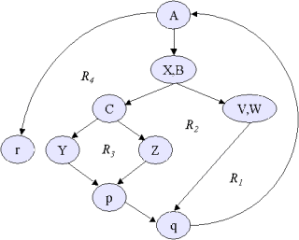
Compiler
Low level
flow
graph
Bytecode
interpreter
Flow
object
space
Flow analysis
RTyper
Anno-
tation
Type
annotated
flow
graph
Flow
graph

Slide 15
Low level
flow
graph
Code
generation
JIT
generation
POSIX
JVM
CLI
...
POSIX
(JVM)
(CLI)
...
Garbage
collector
PyPy interpreter
with Just In Time
Optimizations
X

